Slide 1
Predicting House Prices with Machine Learning
Understanding the Client and their Problem
A benefit to this study is that we can have two clients at the same time! (Think of being a divorce lawyer for both interested parties) However, in this case, we can have both clients with no conflict of interest!
Client Housebuyer: This client wants to find their next dream home with a reasonable price tag. They have their locations of interest ready. Now, they want to know if the house price matches the house value. With this study, they can understand which features (ex. Number of bathrooms, location, etc.) influence the final price of the house. If all matches, they can ensure that they are getting a fair price.
Client Houseseller: Think of the average house-flipper. This client wants to take advantage of the features that influence a house price the most. They typically want to buy a house at a low price and invest on the features that will give the highest return. For example, buying a house at a good location but small square footage. The client will invest on making rooms at a small cost to get a large return.
Loading Data and Packages

Slide 2
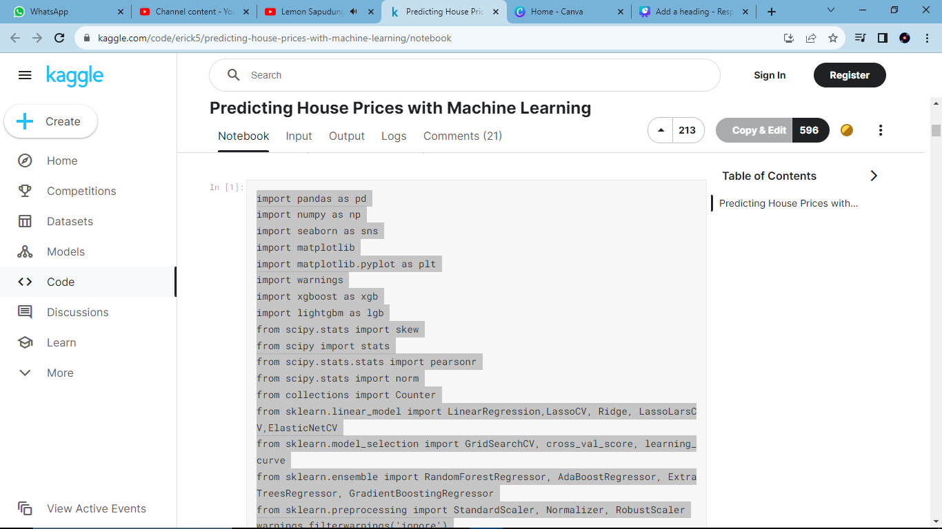
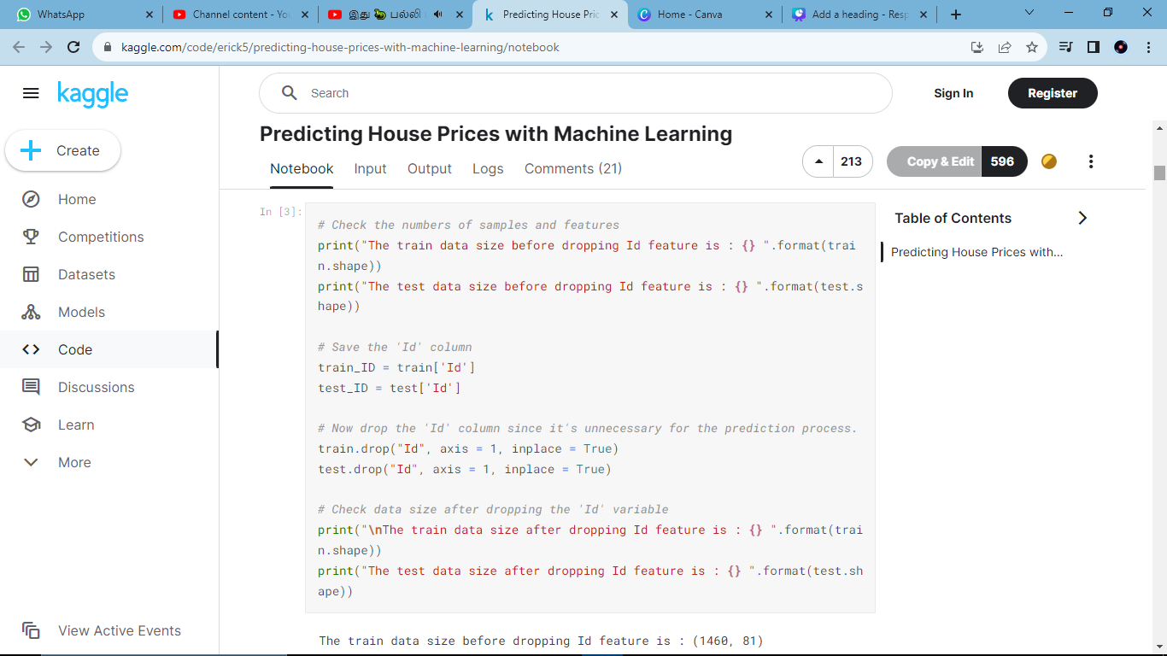

Slide 3
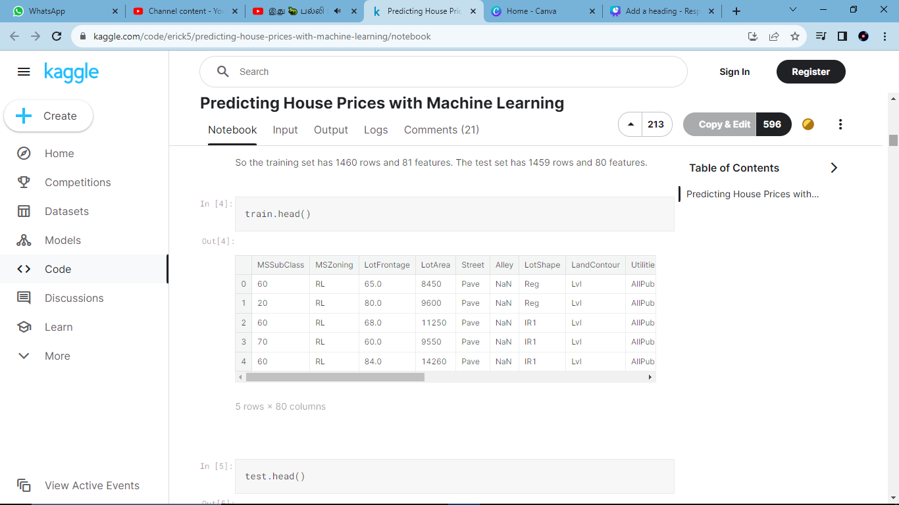
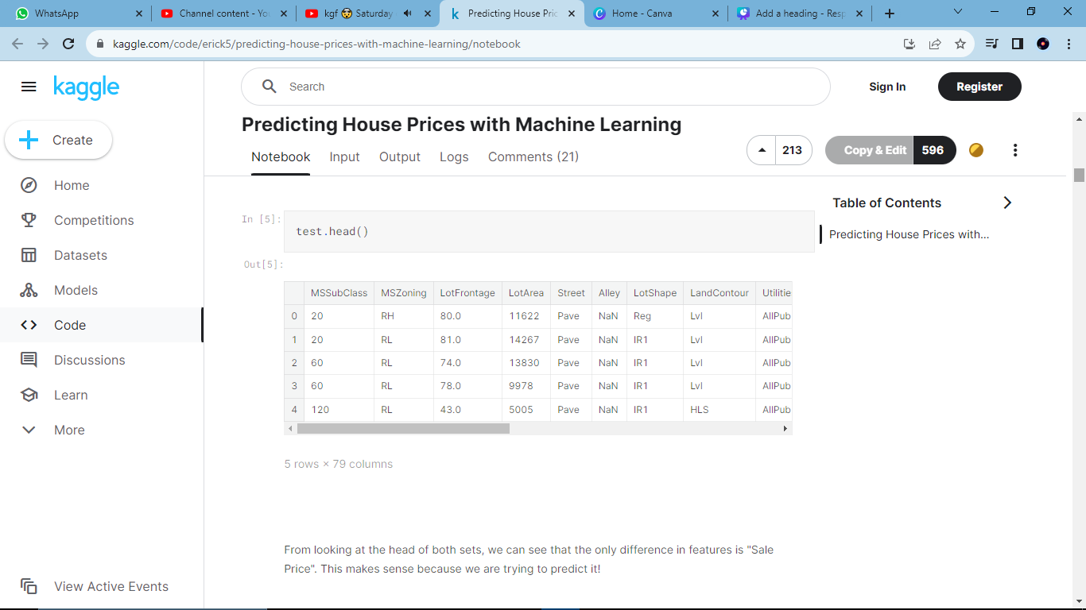
2. Analyzing the Test Variable (Sale Price)
Let's check out the most interesting feature in this study: Sale Price. Important Note: This data is from Ames, Iowa. The location is extremely correlated with Sale Price. (I had to take a double-take at a point, since I consider myself a house-browsing enthusiast)

Slide 4
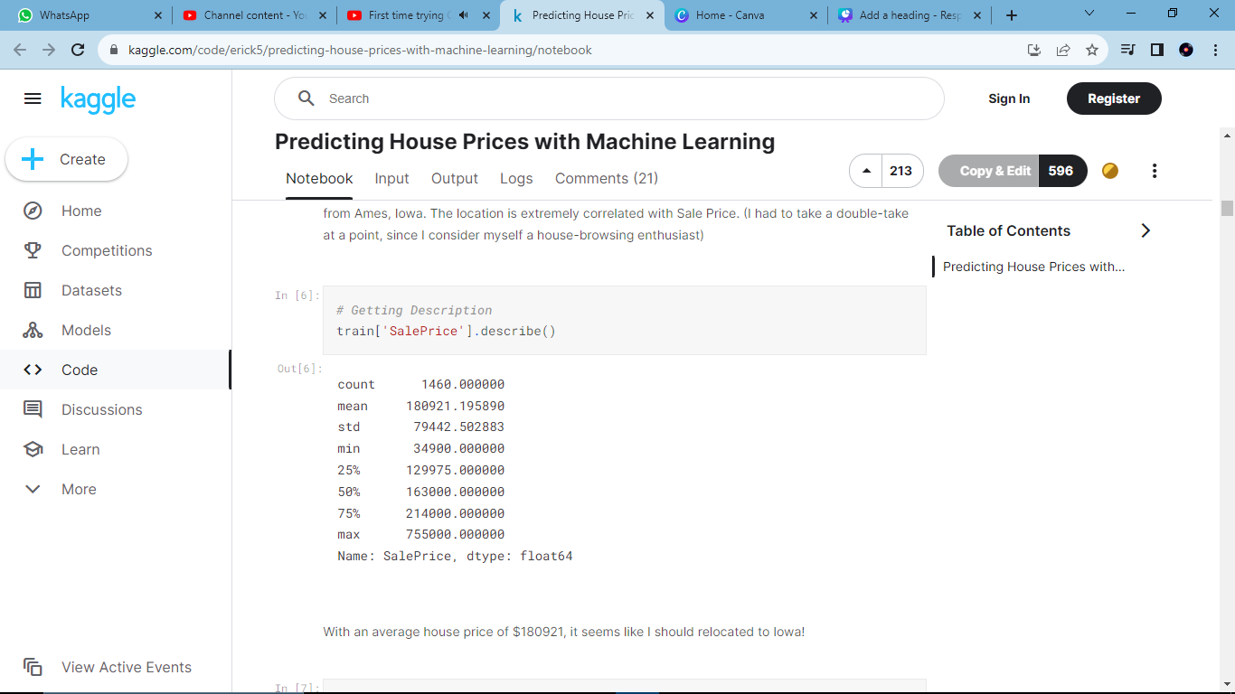
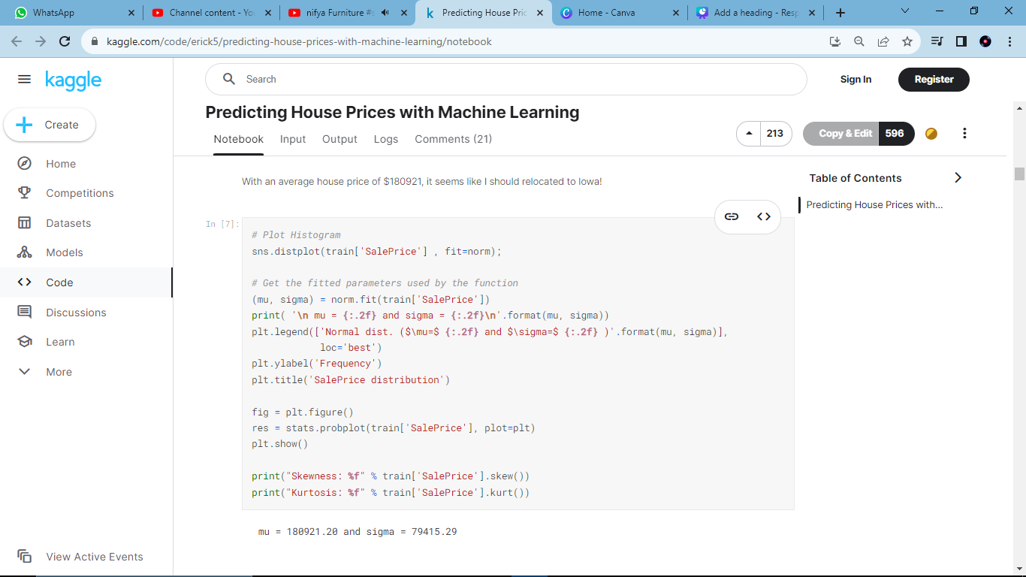

Slide 5
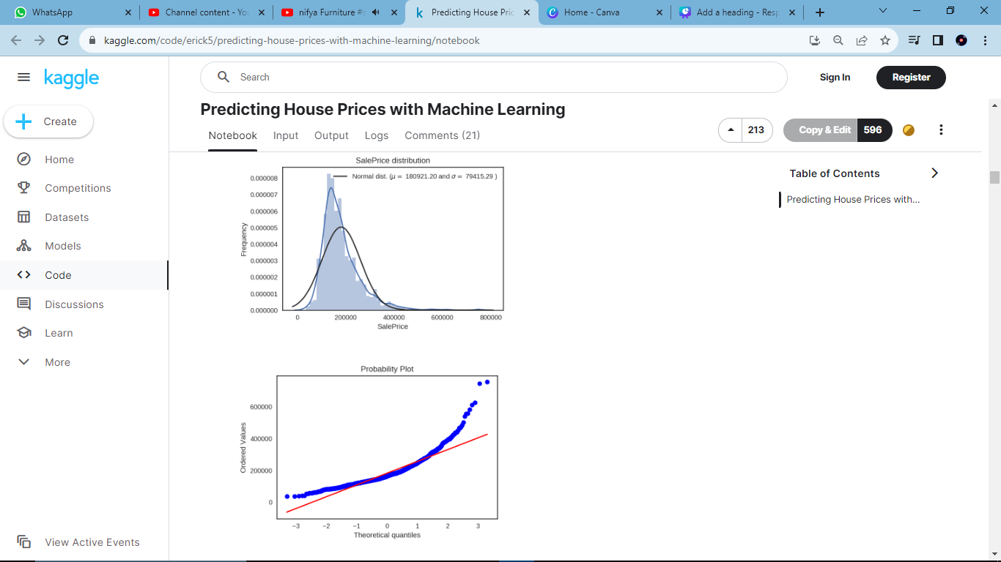
Skewness: 1.882876
Kurtosis: 6.536282
Looks like a normal distribution? Not quite! Looking at the kurtosis score, we can see that there is a very nice peak. However, looking at the skewness score, we can see that the sale prices deviate from the normal distribution. Going to have to fix this later! We want our data to be as "normal" as possible.

